Slide 1
Music Moderation
11-03-2022

Slide 2
AGENDA
MultiModal convolutional neural networks approach.
Challenges faced.
OMR Approach
Experiment on Flowkey dataset.
Way forward.

Slide 3
MultiModal CNN approach
Addresses:
Supervised approximation for score following directly in sheet music images.
Multimodal joint embedding space learning for ‘piece identification’.
Both are built on the multimodal neural networks that learn their behavior purely from observations presented during training.

Slide 4
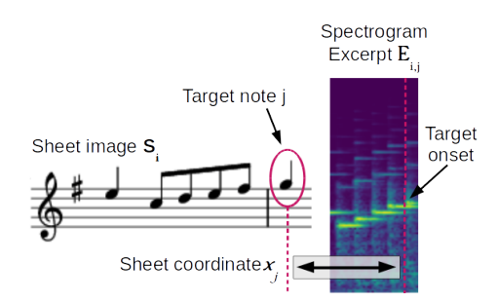
Supervised Score Following
Predicts the most likely position of the audio in the score.
For training, model is presented with triples of
(1) staff image Si (showing one staff of sheet music).
(2) spectrogram excerpt Ei,j and
(3) For a note ‘j’ distance of the note head (in pixels) from the left border of the image , ‘xj’ is hand annotated.

Slide 5
Challenges
For training on our dataset, We require:
Annotation of ground truth pixel x-coordinate xj to in sheet image Si.
For inference:
Model requires data to be inform of data in MSMD dataset.
Notes:
Piano pieces are divided into
1) Score (sheet music)
2) and MIDI audio
As part of preparing this dataset :
For the Score image , annotated bounding boxes are created around the individual staff lines along with the positions of the note heads (in pixel coordinates).
And for each annotated note head in the image a pointer referring to its corresponding onset time in the audio is also obtained.
Alignment is done so that the ordering of noteheads in the score corresponds to the ordering of the notes in the MIDI file.

Slide 6
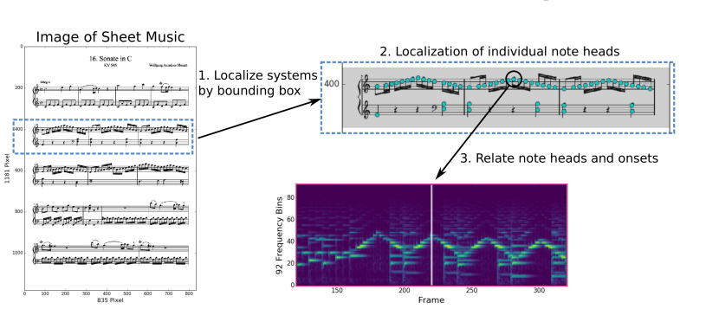
MSMD Dataset
Bounding boxes around the individual staff.
Positions of the note heads associated with these staff.
Location (in pixel coordinates) for each notehead.
Onset time in the audio for the notehead .

Slide 7
Piece identification
Joint embedding space learning.
Query : Entire audio recording .
Identify: Respective piece of sheet music.
Query : A score (sheet-image),
Identify : A set of corresponding performances.
Idea is that the joint embedding space allows for a semantic comparison between entities across the two modalities.

Slide 8
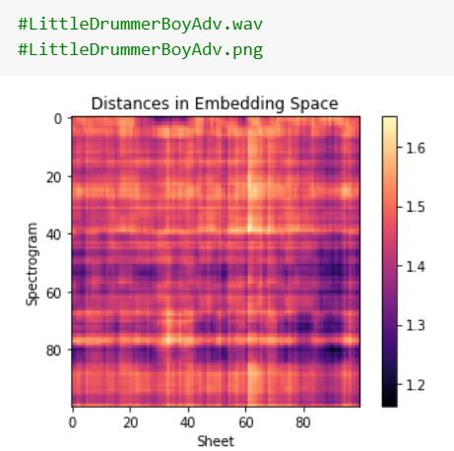
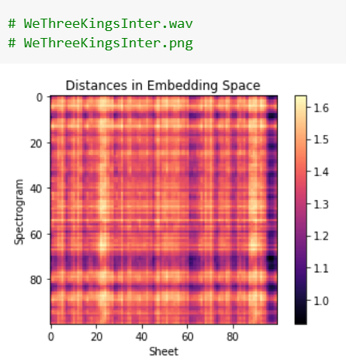
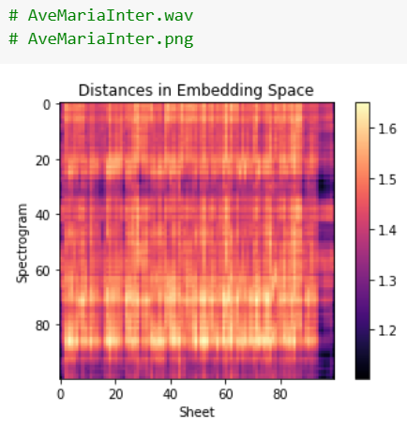
Challenges
Calculated pairwise distance matrix and plotted the embeddings together.
Items from either modality can be retrieved using nearest-neighbor search .
Notes:
Given a spectrogram excerpt A as a search query we want to retrieve the corresponding sheet image snippet I.

Slide 9
OMR approach
Extracting stafflines
Extracting noteheads
Analyzing notehead boxes
Instantiating notes
Grouping noteheads
Extracting symbols
Extracting rhythm types
Building MusicXML document
Oemer (End-to-end OMR) https://github.com/meteo-team/oemer
Notes:
We did not focus on its nitty gritty technical details at the moment.
Focus was on running the model for our dataset and get its accuracy.

Slide 10
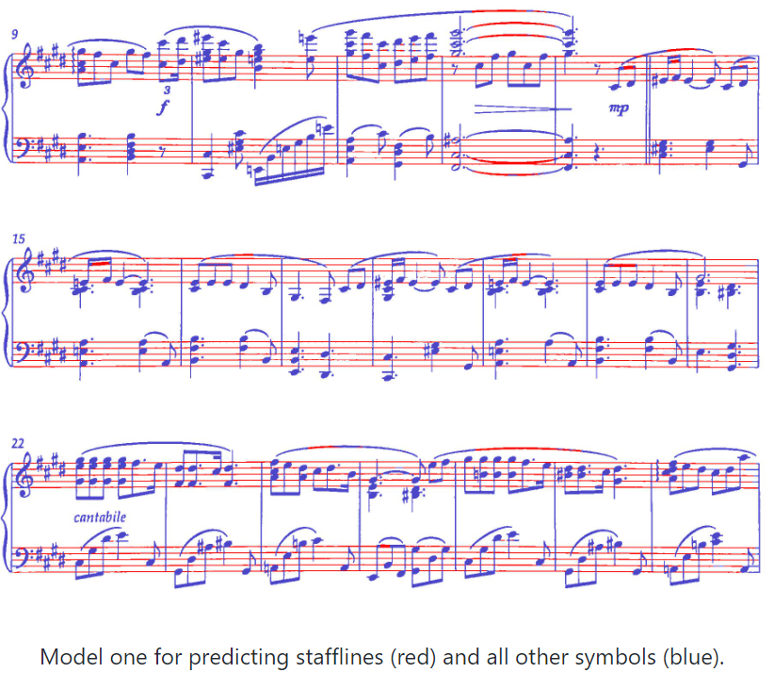
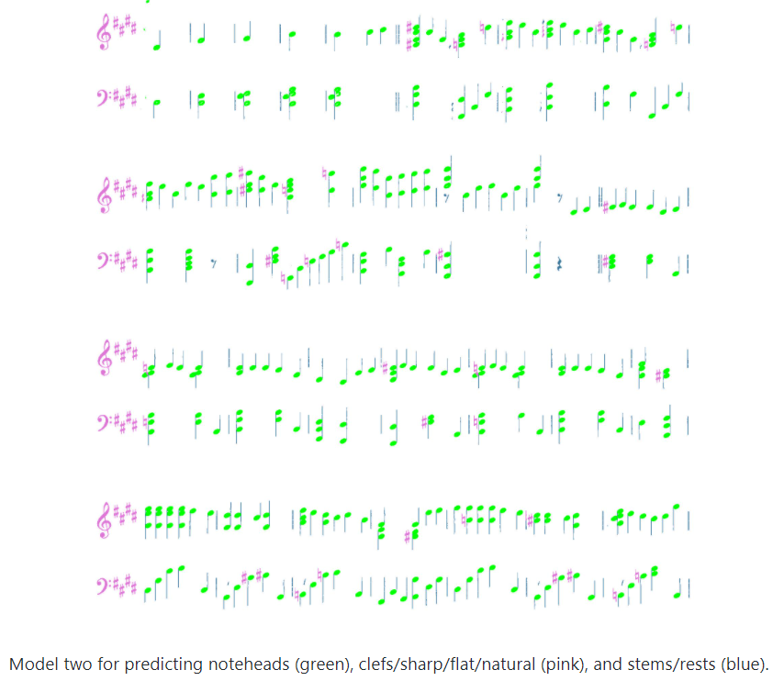

Slide 11
Pipeline flow
Download Flowkey Dataset
WAV files
PNG files
AMT (Automatic Music transcription)
OMR (Optical Music Recognition)
MIDI file
Musicxml file
Extract Notes using ‘music21’
Calculate Accuracy

Slide 12
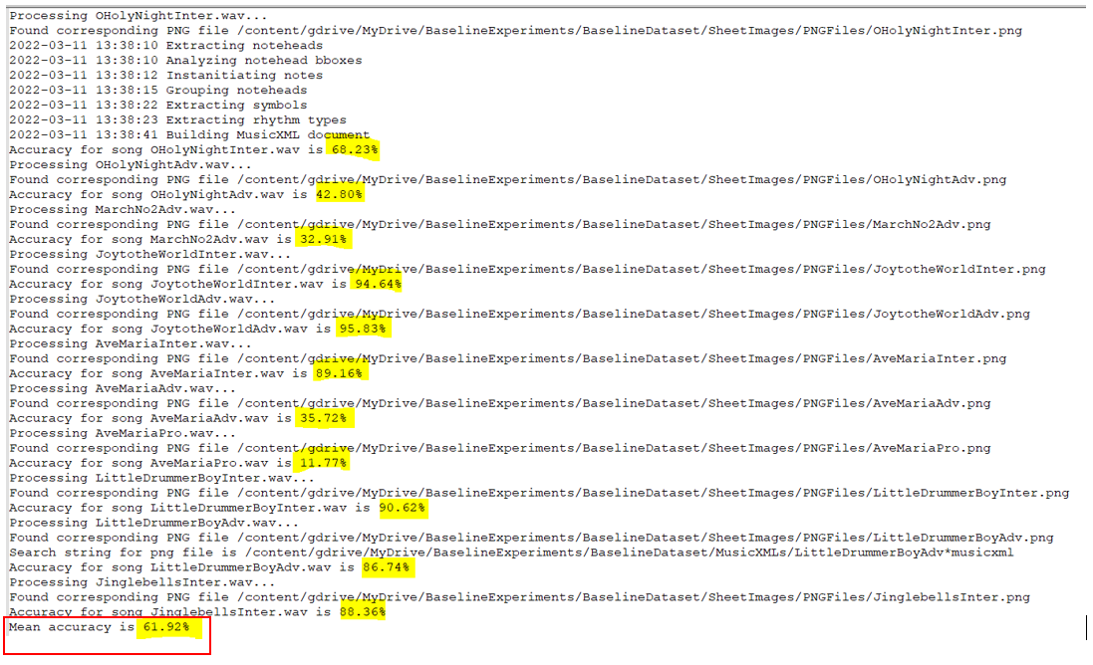
Flowkey
Dataset

Slide 13
Further work
Modify the OEMER code to directly return a list of notes instead of forming the music xml file.
Otherwise, parse the music xml file in a proper manner.
Run the end to end pipeline for whole of the dataset.

